Slide 1
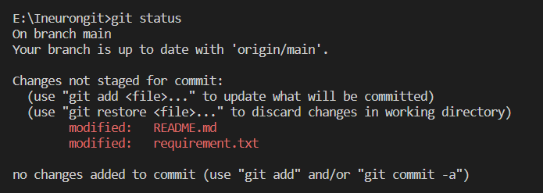
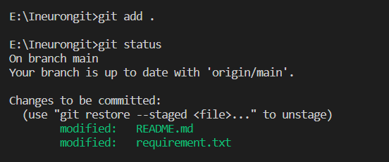
Task 1
Demonstrate minimum 15 basic Git command with explanation and screenshot.

Slide 2
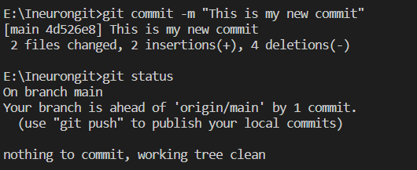
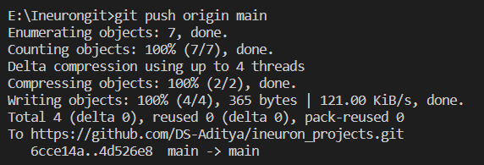

Slide 3



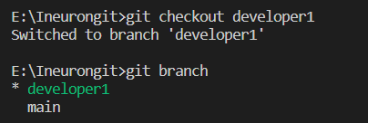

Slide 4


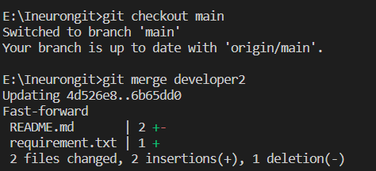

Slide 5

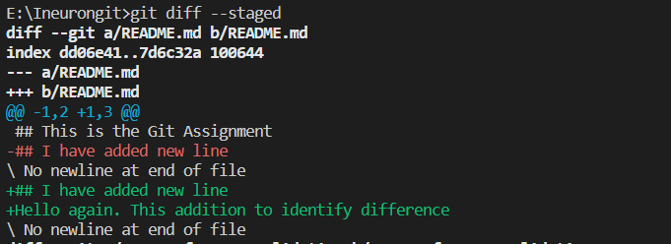

Slide 6

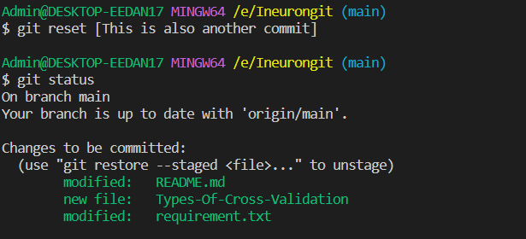

Slide 7

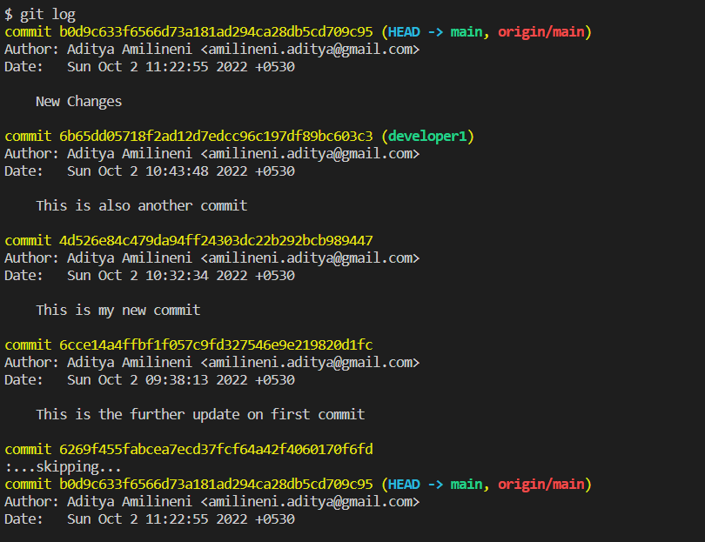

Slide 8

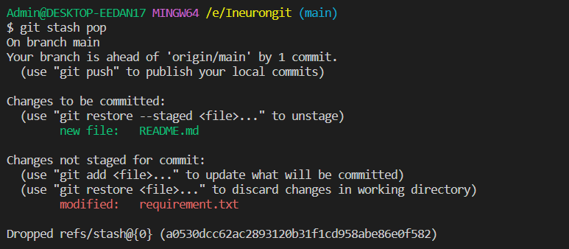

Slide 9
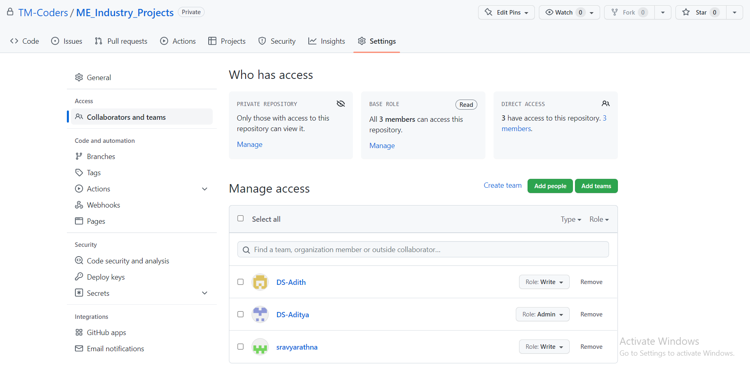
Task 2
Consider that your want to start an open-source project in your organization. Perform all the standard operation to create a repository with minimal permision for all the users. It should contain.
Proper open source structure
Proper Readme
Add 2 collaborator
Host GitHub Pages using settings (Designed to host your personal, organization, or project pages from a GitHub repository)

Slide 10
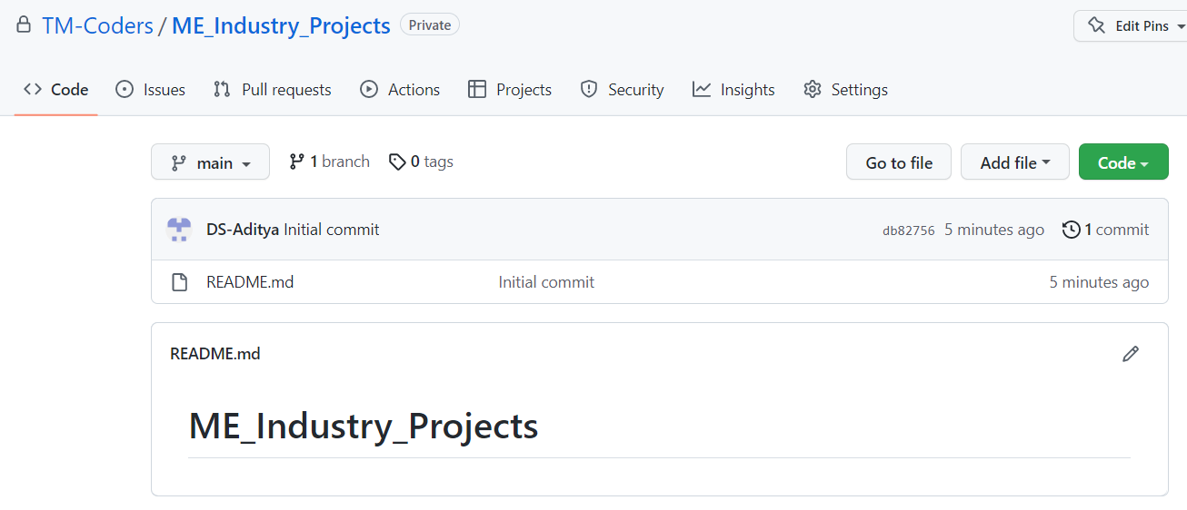
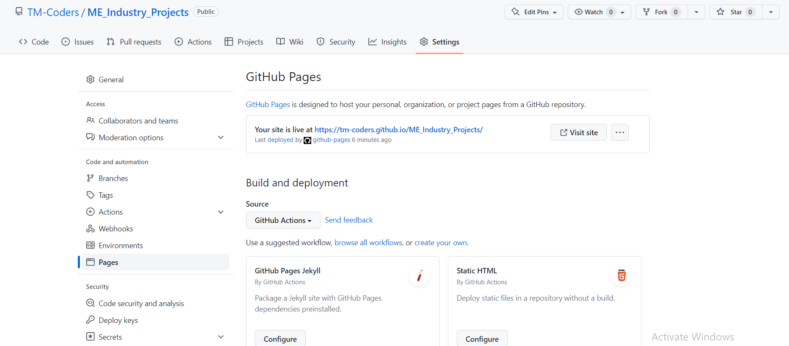

Slide 11
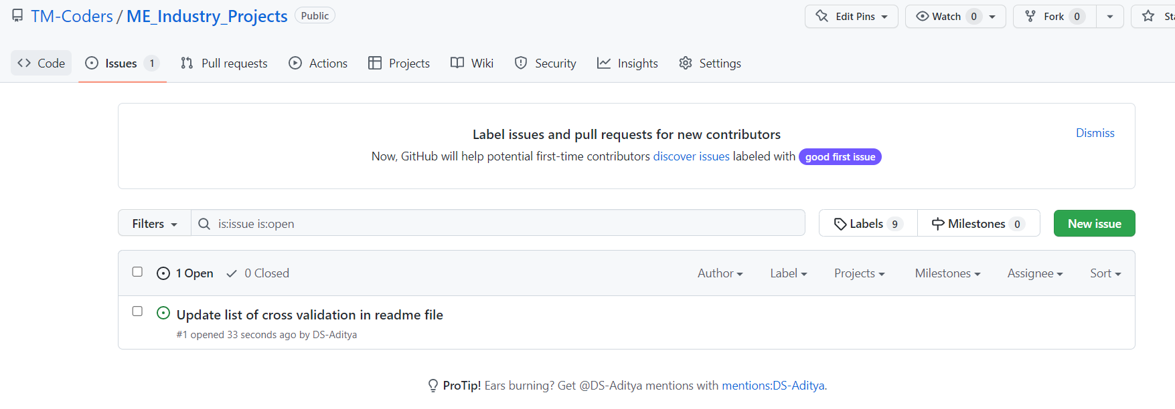
Task 3
Create a Issue in your github repository.
Raise a pull request.
Merge A pull request.
Reject a pull request with proper comments.
Add a Dependabot alerts in your github.(for above cases)
Stash changes
Create a release your package
Setup a Projects Board for your project.

Slide 12
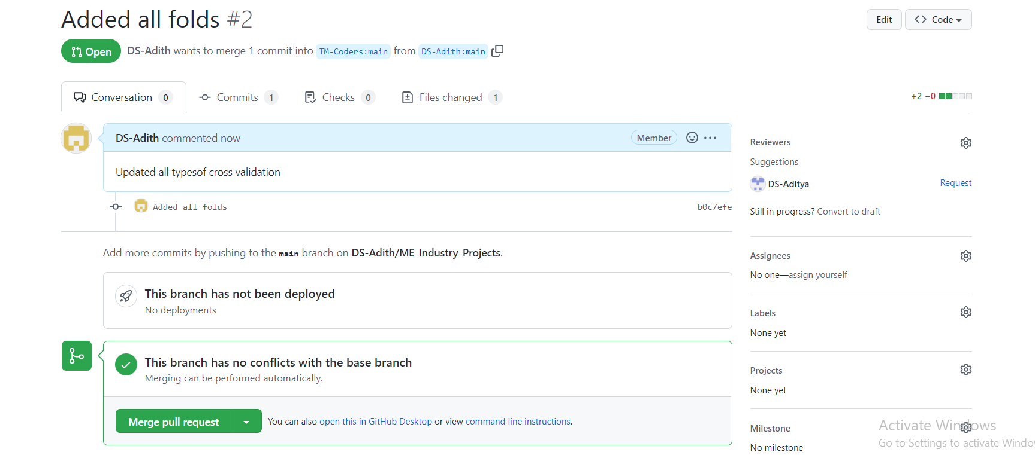
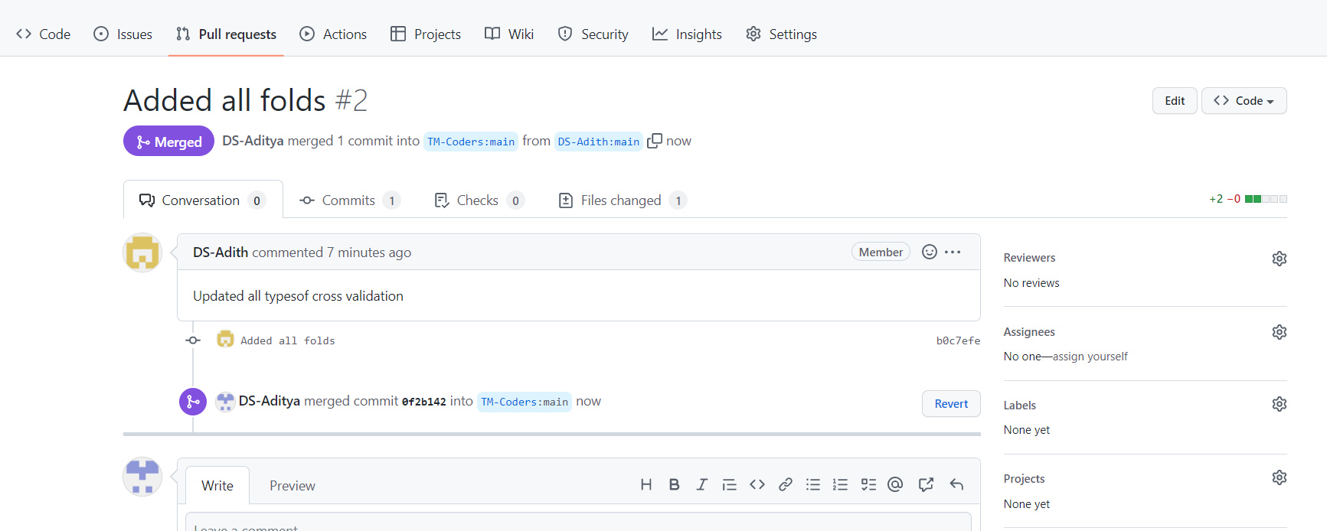

Slide 13
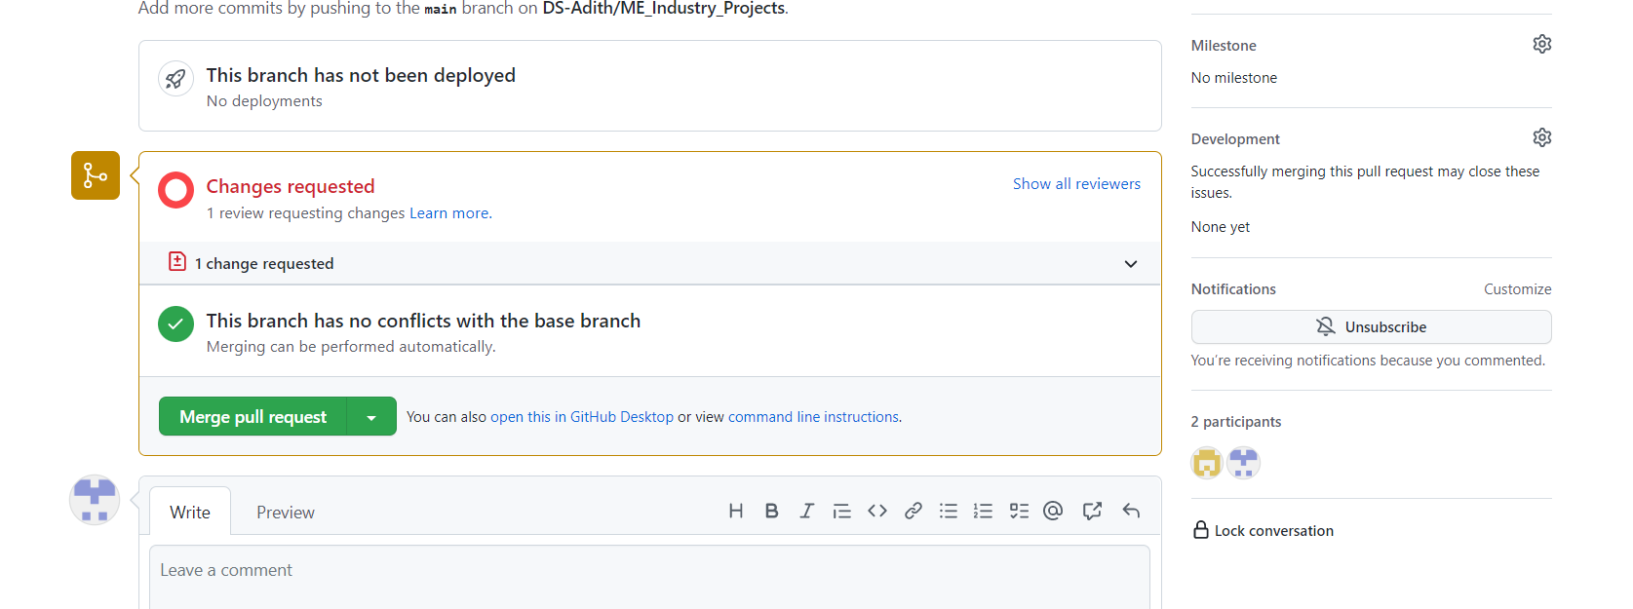

Slide 14
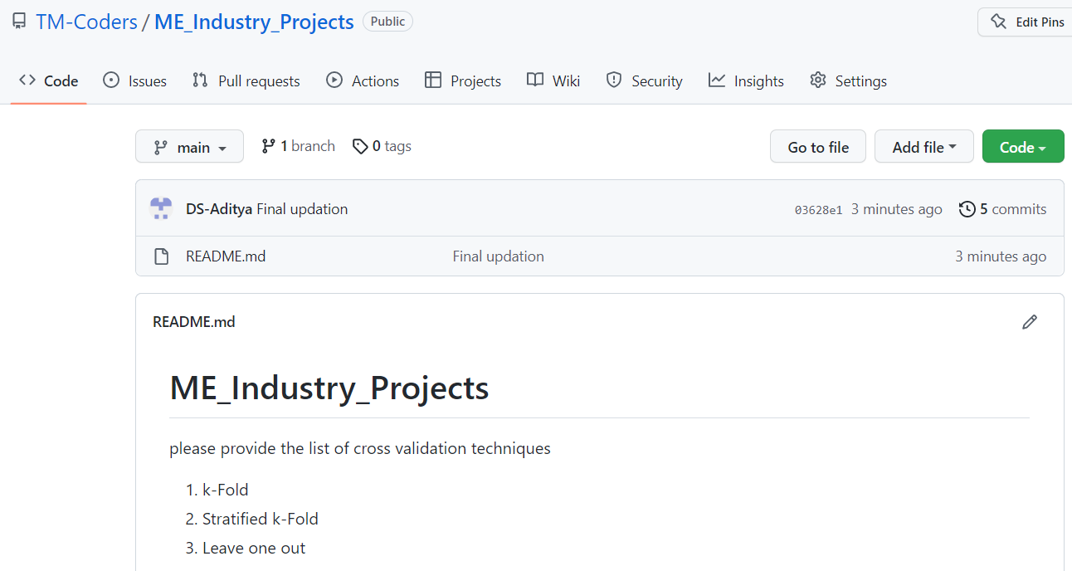

Slide 15


Slide 16
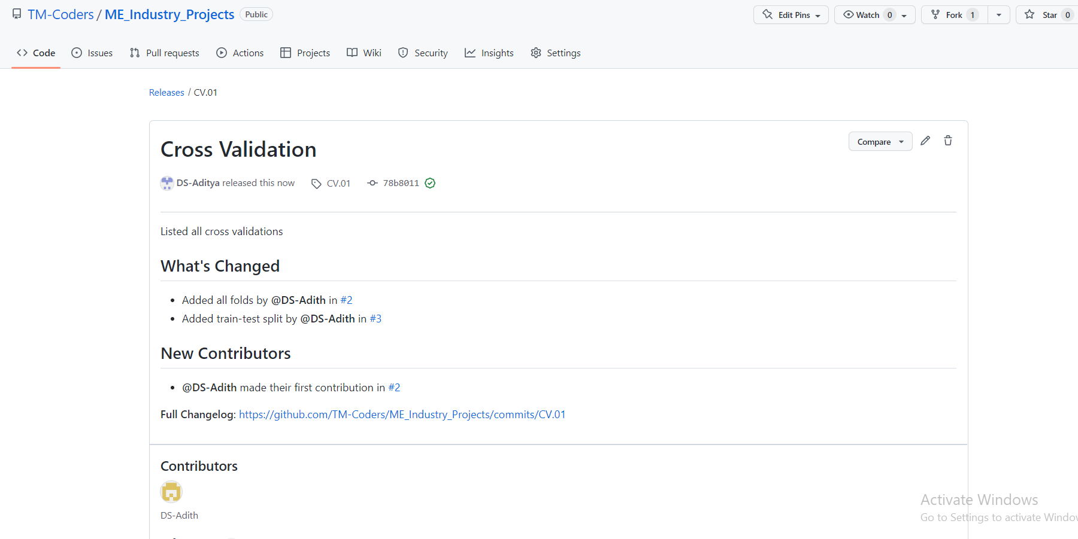

Slide 17
